Slide 1
Welcome to Himilcon’s lab for EDUC 275B (Data II)!
Lab 2
Thursday, February 1, 2024
Himilcon Inciarte
himilcon_Inciarte@berkeley.edu

Slide 2
Upcoming Assignments
Quiz 1a:
02/4/2024
Homework 1 & 2:
02/5/2024
Project 1:
03/22/2024

Slide 3
Practice

Slide 4
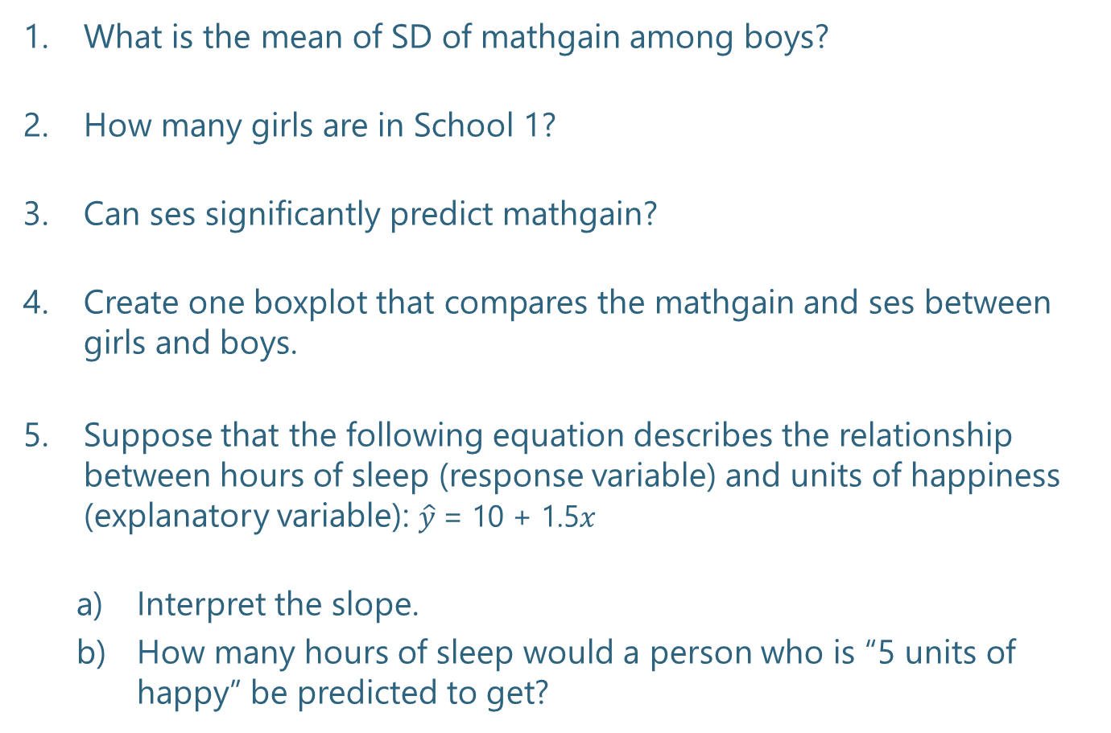
What is the mean of SD of mathgain among boys?
How many girls are in School 1?
Can ses signiﬁcantly predict mathgain?
Create one boxplot that compares the mathgain and ses between girls and boys.
Suppose that the following equation describes the relationship between hours of sleep (response variable) and units of happiness (explanatory variable): $\hat{y}$= 10 + 1.5$x$
Interpret the slope.
How many hours of sleep would a person who is “5 units of happy” be predicted to get?

Slide 5
Quiz 0

Slide 6
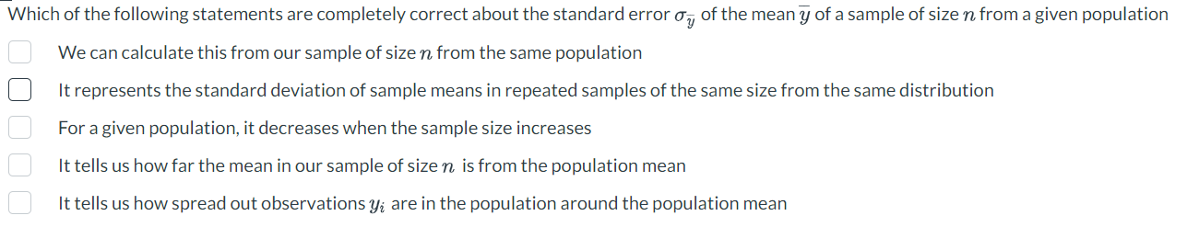

Slide 7
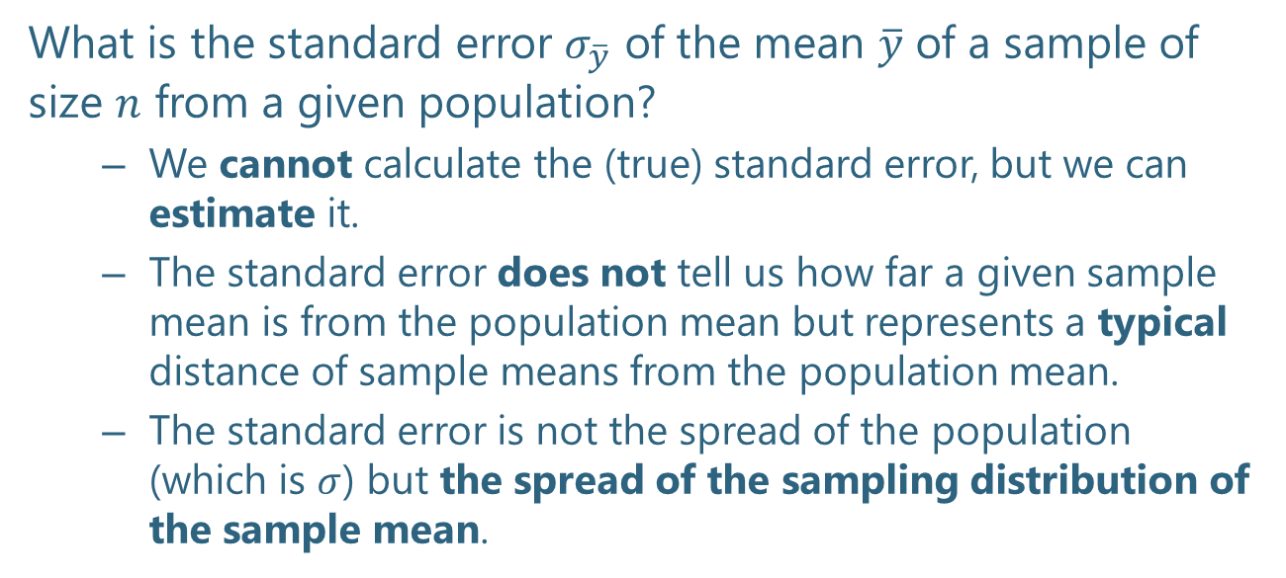
What is the standard error $σ_{\overline{y}}$ of the mean $\overline{y}$ of a sample of size $n$ from a given population?
We cannot calculate the (true) standard error, but we can estimate it.
The standard error does not tell us how far a given sample mean is from the population mean but represents a typical distance of sample means from the population mean.
The standard error is not the spread of the population (which is $σ$) but the spread of the sampling distribution of the sample mean.

Slide 8
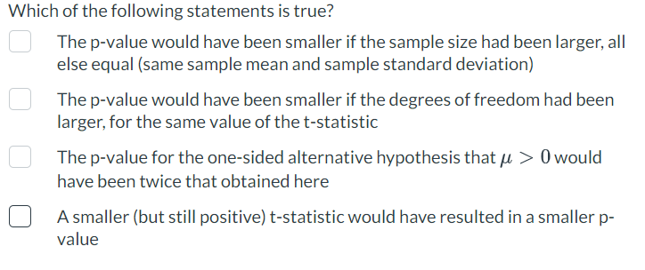

Slide 9
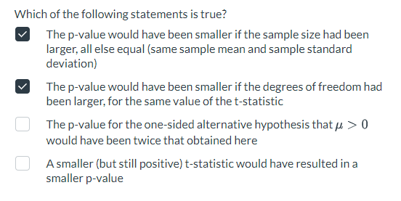

Slide 10
Lab 02.do

Slide 11
HW 1 and 2

